Slide 1


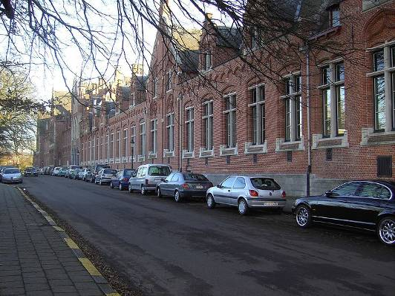
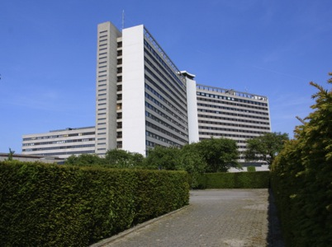
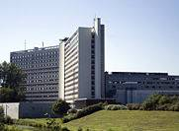
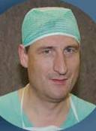
A. Use of Deep Muscle Relaxation in Laparoscopic Bariatric Surgery: J P Mulier
B. Importance of Deep Muscle Relaxation for the Laparoscopic Surgeon: B Dillemans
C. Reversal of Neuromuscular Blockade (NMB) in Morbidly Obese Patients: P Van Lancker
D. Using ERAS (enhanced recovery after surgery) for Laparoscopic Bariatric Surgery: J P Mulier
Cape international 6 7 March Bruges 2012
1150 1850 1947 1977 2010
Jan Paul Mulier MD PhD
Anaesthesiologist
Sint-Jan Brugge-Oostende, Belgium

Slide 2
A. Use of Deep muscle relaxation in laparoscopic surgery
Are surgeons right to complain of insufficient use of NMB during a pneumoperitoneum?
Impact of muscle relaxation on the abdominal compliance in normal and obese patients.
Need every laparoscopic procedure deep muscle relaxation till the end of surgery?

Slide 3
Classical Indications for NMB
Textbook indication for NMB:
  To facilitate vocal records relaxation during endotracheal intubation.
  To establish and maintain good surgical conditions: good relaxation of muscles within the surgical field.
  NMB can sometimes be combined with a lighter level of anesthesia;
  Profound NMB can avoid even the slightest patient movement when precision is critical
NMB=neuromuscular blockade.
Miller RD. In: Miller's Anesthesia Seventh Edition. 2010. Churchill Livingstone.
Notes:
Neuromuscular block is generally used:
To facilitate vocal records relaxation during endotracheal intubation.
To establish and maintain good surgical conditions, in other words, good relaxation of muscles within the surgical field.
Sometimes NMB can be combined with a lighter level of anesthesia
In situations where surgical precision is critical, profound NMB can avoid even the slightest patient movement

Slide 4
Why are we trained to give insufficient NMB?
Stop relaxation early to allow neostigmine to work
  TOF two counts is deep enough?
To prevent post operative bad respiration, low saturation, hypercarbia, respiratory failure.
Rest relaxation is very anxious for the patient.
Use spontaneous recovery to avoid neostigmine induced:
  Bradycardia - total AV block
  Bronchospasm
  PONV
No reason now with Sugammadex
But some anesthesiologists question the use of NMB during laparoscopy now.

Slide 5
Limited literature on the use of NMB during laparoscopy!
The effects of NMB on peak airway pressure and abdominal elastance during pneumoperitoneum.
  Chassard D Anesth Analg 1996; 82: 525
  Pigs have a non linear behaviour different from humans
  Elastance is not changing either in humans
Gynecologic laparoscopy with or without curare?
  Chassard D Ann Fr Anesth Reanim 1996; 15: 1013
  Surgeon was asked if he could work. Additional dose is given if he could not work
A comparison of the effect of two anaesthetic techniques on surgical conditions during gynaecological laparoscopy
  Williams MT. Anaesthesia. 2003; 58: 574
    Without curare shorter operation, higher PV0, trocar placement difficult.
No supplemental muscle relaxants are required during propofol and remifentanil total intravenous anesthesia for laparoscopic pelvic surgery.
  Peak CM J laparoendosc Adv Surg Tech 2009; 19: 33
    Effect is not measured .

Slide 6
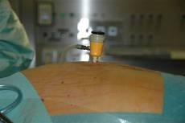
Nevertheless: Surgical comments
Surgeons complain till they are tired or punished
  I have no surgical workspace and the anesthesiologist is not willing to do anything!
  Patient presses en still the anesthesiologist tells that the patient is relaxed. (he measures TOF = 0, I believe in what I see) !
  Some anesthesiologists can give better relaxation than others. Why?
  Anesthesiologist always wait with adding relaxation till it is too late and I have to complain!
  Patient is moving at end of operation although recovery still takes a long time!
But when anesthesiologist gives extra NMB frequently nothing changes and surgeon keeps complaining
  Surgeons are punished by long turnover time due to slower reversal when high dose NMB are used at end.

Slide 7
Patient variability
Inflated volume at 15 mmHg without NMB varies from 0,5 L to 10 L.
Who needs NMB?
Will the surgeon be comfortable?

Slide 8
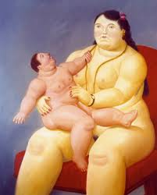
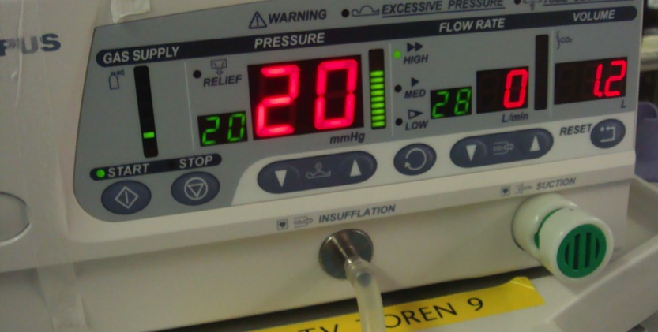
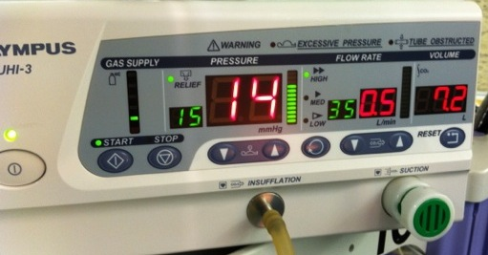
Example: 1,2 L versus 7,2 L
Maximal NMB helps but is not sufficient alone
NMB needed? Depends on the IAP used?

Slide 9
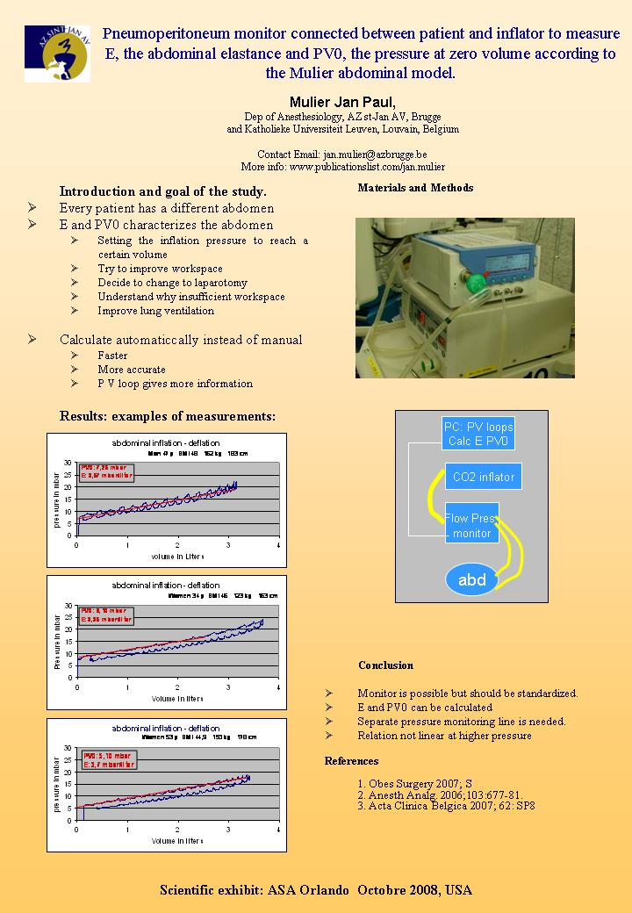
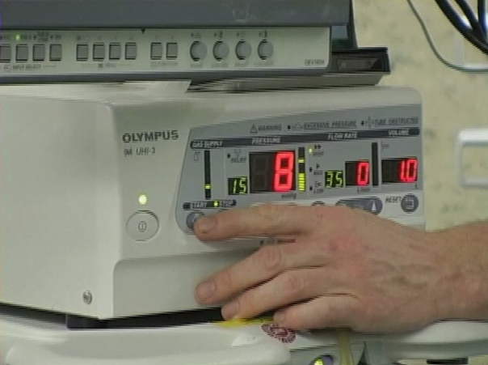
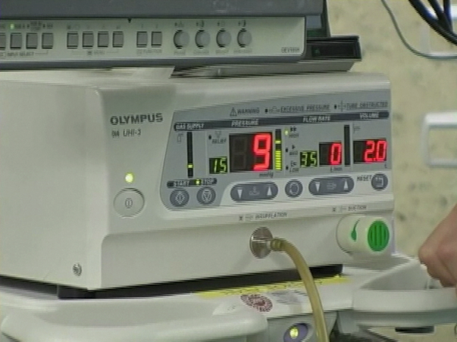
Pressure volume loops
or
Simplified 3 points measurement
or
Look to max vol at 15
PV0 : 7
E: 1 mmHg/L

Slide 10
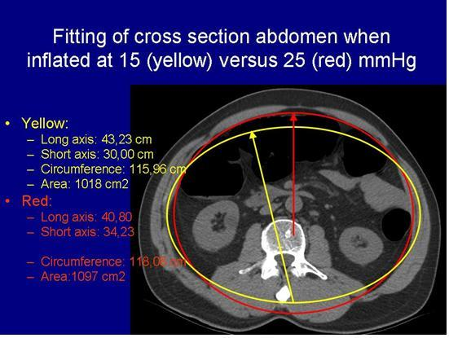
CT scan
Mulier J.P., Coenegrachts CT analysis of the elastic deformation and elongation of the abdominal
wall during colon inflation for virtual coloscopy
Eur J Anesthesia 2008 Suppl

Slide 11
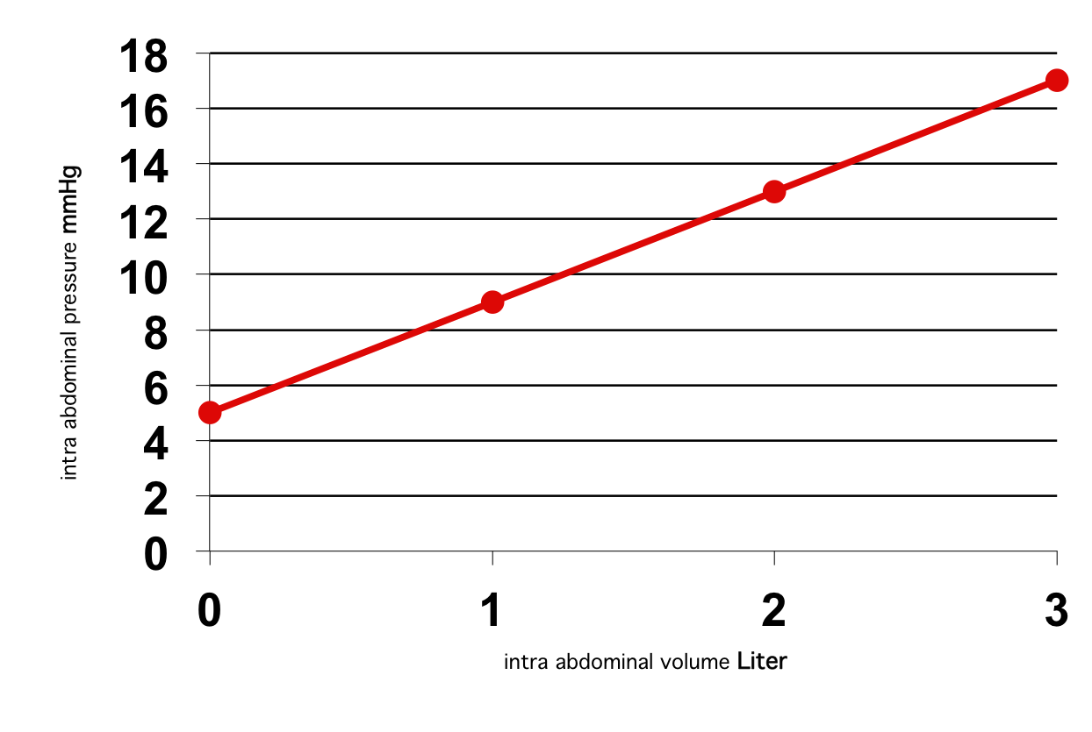
Compliance (C) and Elastance (E)
C=change in V/change in P (C= 1/E)
Higher insufflation pressures needed
PV0 = 5
E = 4 mmHg/l
Insufficient intra abdominal volume
J Mulier, B Dillemans, M Crombach, C Missant, A Sels
On the abdominal pressure volume relationship.
The Internet Journal of Anesthesiology. 2009; 21: 1.

Slide 12
Measuring abdominal compliance during laparoscopic surgery
Movie showing a patient case

Slide 13
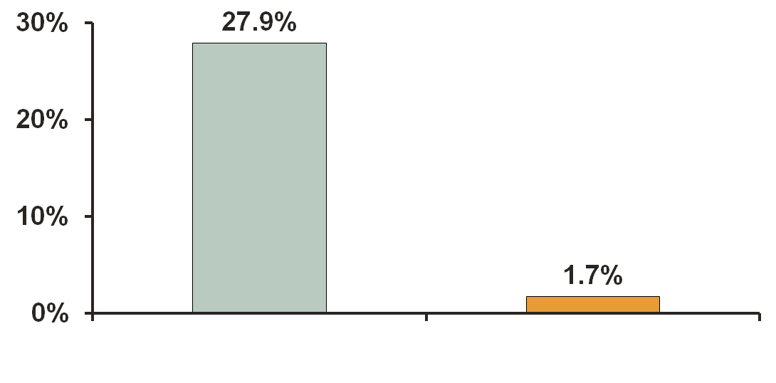
Use of NMBA is Associated With Decreased Frequency of Poor Surgical View Conditions^{1,a}
% Patients with poor surgical view conditions
P<0.001 placebo vs NMBA
Placebo
n=61
NMBA
n=59
ª In a randomized, blinded, placebo-controlled study of 120 patients undergoing radical retropubic prostatectomy, patients received an infusion of NMBA (n=59) or saline (placebo, n=61) beginning 5 minutes after fascial incision. At 15 minute intervals, the surgical field was graded from 1 (excellent) to 4 (unacceptable). Patients who were graded as having an unacceptable surgical field received rescue NMBA.
NMBA=neuromuscular blocking agent.
1. King M. Anesthesiology. 2000;93:1392–1397.
Notes:
1/King:
p1393A,B
1/King:
p1394A,B
The use of neuromuscular blockade (NMB) is also associated with decreased frequency of poor surgical view conditions.
This study investigated the effect of NMBA on the incidence of unacceptable surgical conditions for intra-abdominal surgery.
Surgical conditions were rated using a field rating assessment scale, where a score of 1 indicated excellent surgical view conditions and a score of 4 indicated poor surgical view conditions.
The frequency of treatment failure due to acceptable surgical views was 17 of 61 (27.9%; 95% CI, 17.2–40.8%) for patients receiving placebo compared with 1 of 59 (1.7%; 95% CI, , 0.1–9.1%) for patients receiving NMBA (P=0.001).¹
1. King M. Anesthesiology. 2000;93:1392–1397.
1/King2000: p1394A

Slide 14
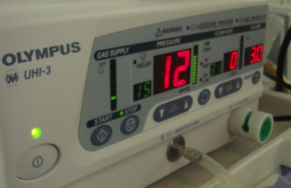
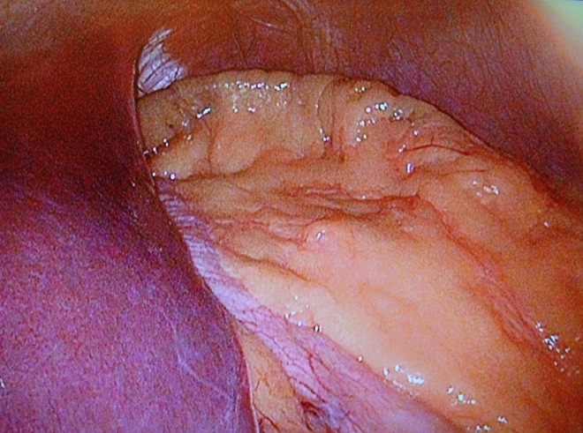
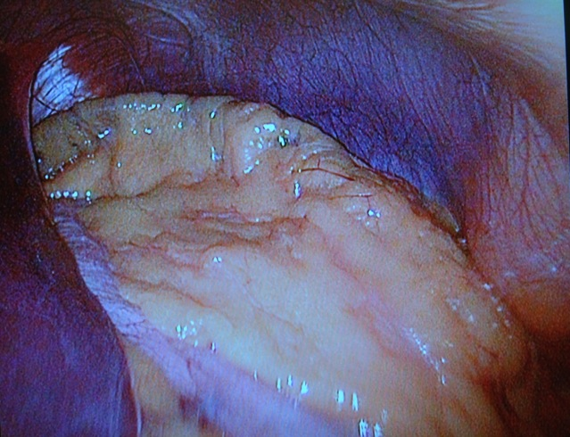
Surgical workspace without - with NMB in one obese patient BMI 46:
PV0 = 9 mmHg drops to 6 mmHg. E remains constant at 2 mmHg/liter
Volume Pressure without NMB Pressure with NMB TOF 0
  1 liter 11 mmHg 8 mmHg
  2 liter 13 mmHg 10 mmHg
  liter 15 mmHg 12 mmHg
  liter - 14 mmHg
  Patient got inhalation Desflurane 1 Mac (what is having a little relaxation as well)
  Remifentanyl infusion with no effect on relaxation
  Ventilation 600 ml 12 x with 7 cm H20 peep
  Rocuronium bolus of 1,2 mg/kg IBW with continuous infusion of 50 mg/hour was given after first measurements
  Second measurements when TOF = 0 at the thumb
Pressure 14 gives volume of 4 liter
Workspace. View is more from above
More space and better access
Pressure 15 gives volume of 3 liter
Workspace.

Slide 15
Pressure volume relation without vs with NMB

Slide 16
Deep muscle relaxation is useful in morbid obese patients
TOF > 90%
TOF = 0/4 and PTC < 10
TOF 0/4 and PTC < 5
J Mulier 2008 ASA
Gradual pressure drop until flat line
Max effect at TOF = 0/4
No need to drop until PTC = 0
Mulier JP 2009 PGA
TOF 4/4 TOF ¼ PTC 10 PTC 5 PTC 0

Slide 17
How improving workspace?
If high PV0 easy to improve
    NMB most effective, trendelenburg, IAP increase
If low C difficult to improve
    Flexing legs, higher IAP and NMB are less effective
NMB helps in both situations!

Slide 18
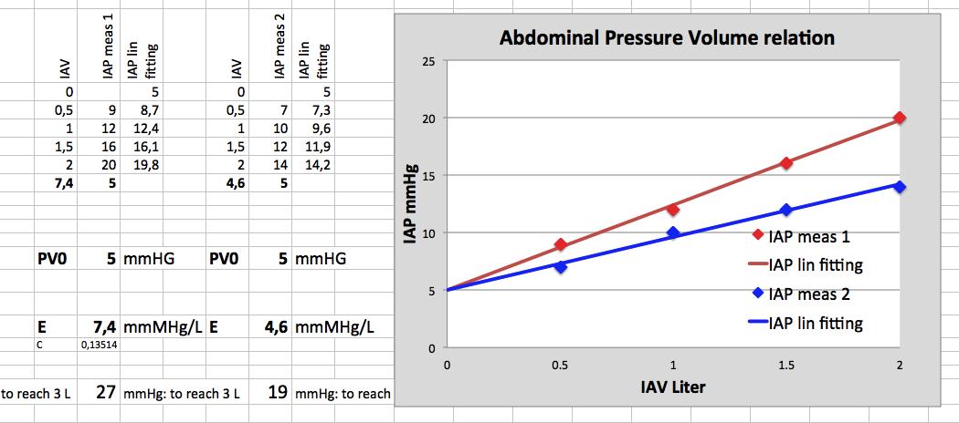
Ex. of three point calculation in the OR

Slide 19
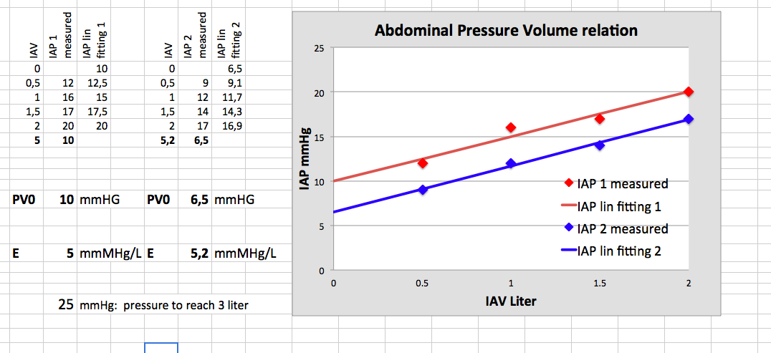
Per operative measurements at first inflation

Slide 20
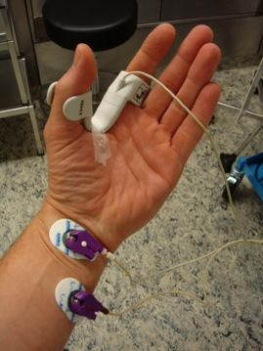
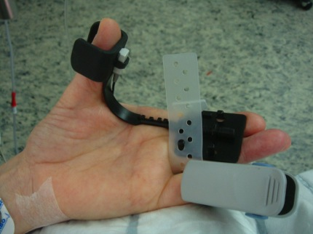
Difference between diaphragm and adductor pollicis
Monitoring of the peripheral muscles often overestimates the degree of diaphragmatic relaxation, but is a save predictor of recovery.
  Moerer O. Anasthesiol Intensivmed Notfallmed Schmerzther. 2005; 40: 217
The vocal cords and diaphragm are more resistant than the adductor pollicis to rocuronium and have a faster recovery of the twitch height.
  Cantineau JP Anesthesiology. 1994; 81: 585

Slide 21
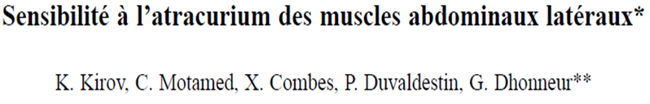
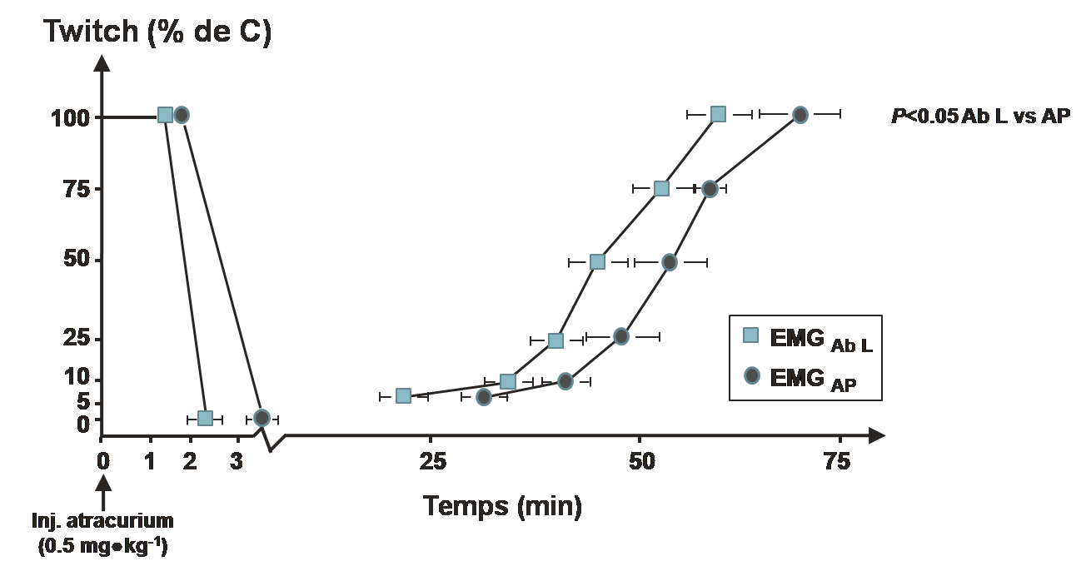
The Benefits of Deep Neuromuscular Blockade: Surgical Procedure
Sensibility to atracurium of the lateral abdominal muscles
Objective: To study the effect of atracurium on the electromyographic activity of the lateral abdominal muscles and adductor pollicis in anaesthetized subjects.
Lateral abdominal muscles blockade have a faster onset and recovery than adductor pollices
Kirov K et al. Ann Fr Anesth Reanim. 2000;19:734–738.
Notes:
21

Slide 22
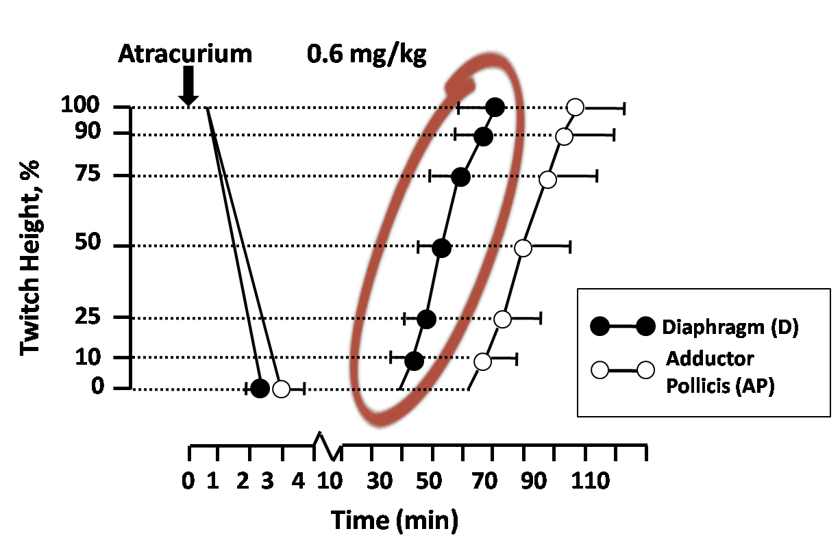
The Benefits of Deep Neuromuscular Blockade: Surgical Procedure
AP and Diaphragm Neuromuscular Block
Diaphragm blockade has a faster onset and recovery than adductor pollices
Pansard, et al. Anesthesiology. 1987;67:326-330.

Slide 23
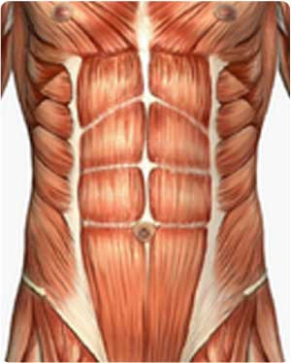
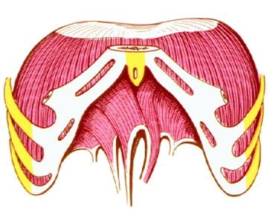

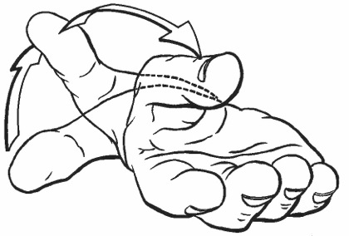
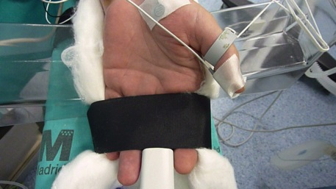


Deep block in abductor pollicis means moderate block in abdominal muscles and diaphragm
Shadow block
Deep block
10 PTCs
Notes:
We have to achieve a deep block at the AP in order to get a shadow block on the abdominal muscles and diafragm
A shadow block on the abdominal muscles and diafragm should ensure enough workspace and good surgical conditions
But
Be careful because sometimes a deep block is not enough
Somtimes the patient can move or cough during the procedure even with a deep block at the AP and we need a deeper level of anestesia or more opioids or even more NMBAs
A deep block at the AP correlates with a shadow block on the abdominal muscles and diafragm

Slide 24
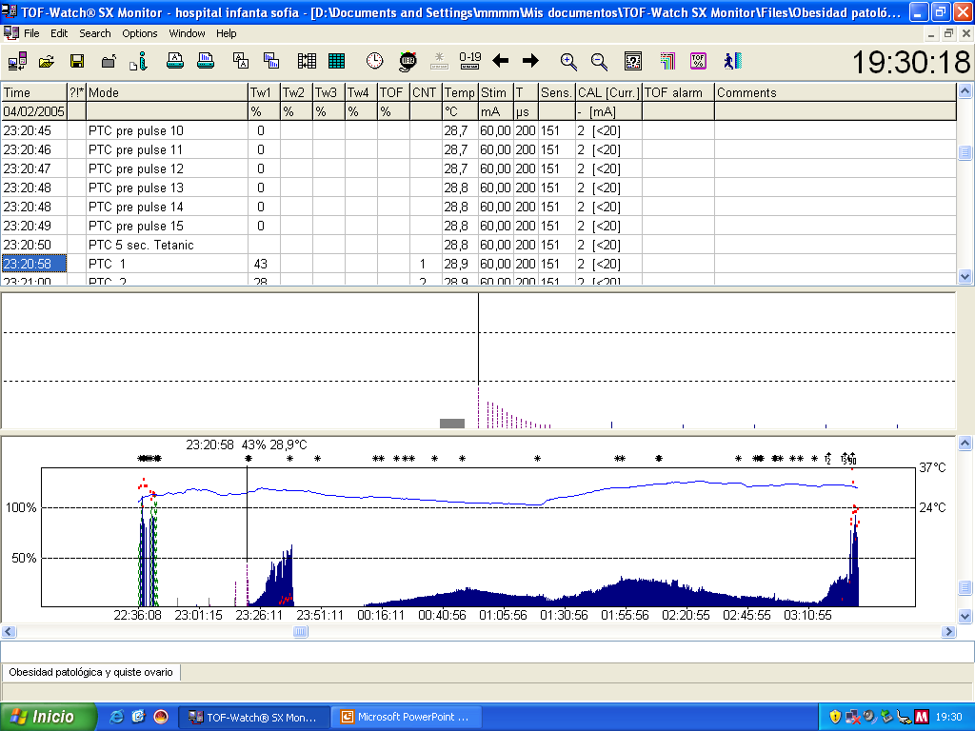
Rocuronium 5-7 ug/kg/min for 1-2 TOF
Gastric By-pass
Anexectomy
IAP 11-12 mmHG
IAP 13-14 mmHG
Notes:
After 0.6 mg/k of rocuronium the patient was intubated and we achieved a deep block
At this point having the patiente 8-10 PTCs (señalar y poner foto de aguja de verres), we made the measure of the APVR and we calculate the PV0 and the Elastance
We noticed that a deep block was not necessary so we keep the patient on a shadow block just with 1-2 TOF response at AP with a continium infusion of rocuronium beteween 5-7 ug/kg/min
During the gastric bypass procedure, the patient was on a antitrebdelenburg position, the IAP was 11-12 mmHg and the surgeon had good surgical conditions and enough workspace
During the anexectomy procedure, the patient was changed to a trendelenburg position and the IAP rose to 13-14 mmHg, having the surgeon good surgycal conditions and enough workspace
You have to take into account for the patient had had in importan weight loss (which improve de elastence) and the gastric procedure was done in a antitrendelenburg position (which lower the PV0)

Slide 25
We can choose the lowest IAP possible by using max NMB
Mulier JP 2007

Slide 26
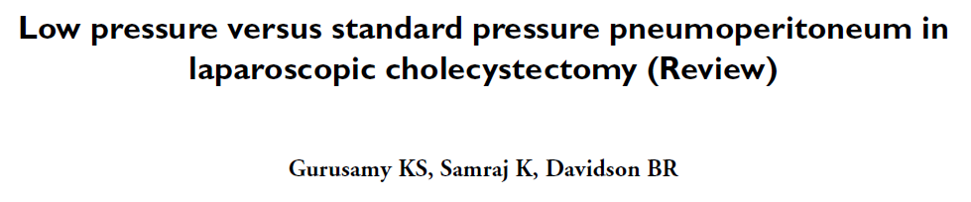
The Benefits of Deep Neuromuscular Blockade: Surgical Procedure
Authors’ conclusions
  Low pressure pneumoperitoneum appears effective in decreasing pain after laparoscopic cholecystectomy
  The safety of low pressure pneumoperitoneum has to be established
Could NMBAs limit increase in insufflation pressure?
Gurusamy KS, et al. Cochrane Database Syst Rev. 2009.

Slide 27
Determinants of E and PV0
 | PV0 | P_{VO} sig | E | E sig
Age | Neg | 0.828 | Pos | 0.003*
Length | Neg | 0.356 | Neg | 0.245
Body weigth | Pos | 0.012* | Pos | 0.294
Bmi | neg | 0.054 | Neg | 0.272
Sex | Neg | 0.596 | Neg | 0.536
Gravidity | Neg | 0.305 | Neg | 0.049*
Prev abd operation | Neg | 0.191 | Neg | 0.009*
Muscle relaxation | Neg | 0.001* | Neg | 0.376
* Sig p<0.05
Mulier JP 2007

Slide 28
Effect of table position on APVR
PV0 decreases
E no change
PV0 | 5,037 | > | 4,122 | > | 3,835
E | 3,459 | = | 3,368 | > | 3,217
Mulier JP Obes Surg 2009

Slide 29
Effect of leg flexion on APVR
PV0 no change
E decreases
5,037 | = | 4,91096
3,368 | > | 2,577
PV0 | 4,320 | = | 4,76571
E | 3,459 | > | 2,66067
Mulier JP Obes Surg 2009

Slide 30
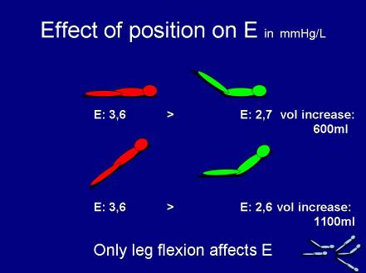
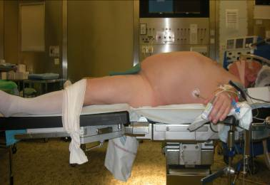
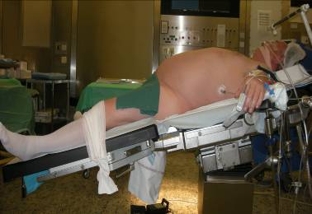
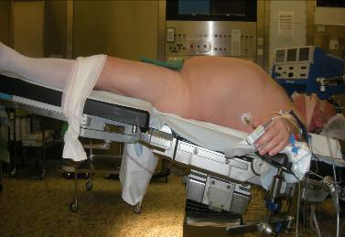
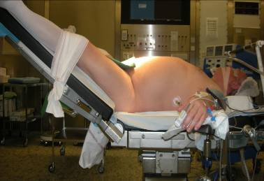
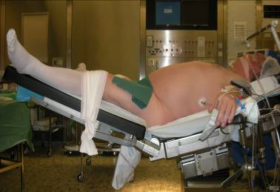
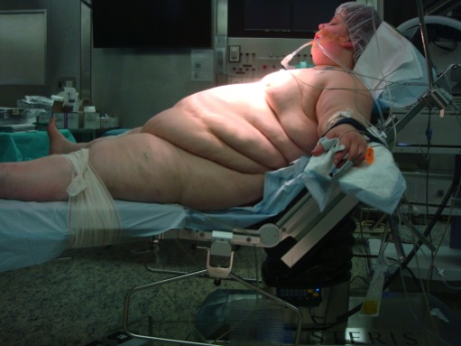
How to change E : hip flexion
Mulier JP Obes Surg 2009

Slide 31

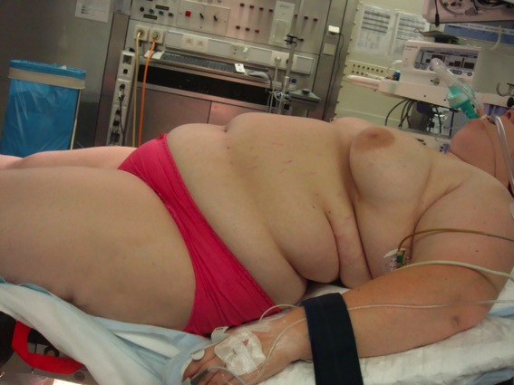
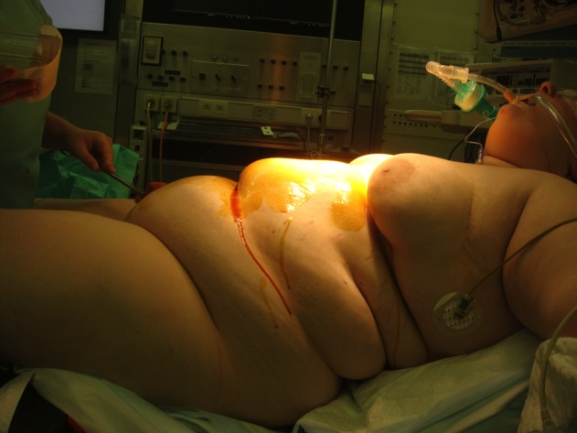
Avoid too much leg flexion if “Double bubble abdomen”
Lift legs just above horizontal
  Reduce venous stasis and trombosis risk
But keep outside space free for laparoscopic instruments

Slide 32
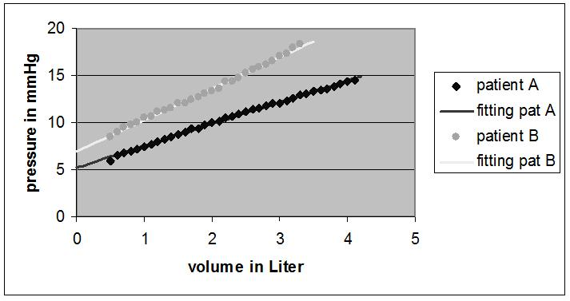
BMI effect on abdominal P/V relation
J Mulier ISPUB 2009
  Pressure volume relation is linear
  PV0 and E are patient determined
J Mulier IFSO 2007

Slide 33
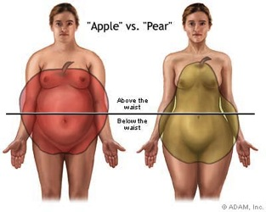
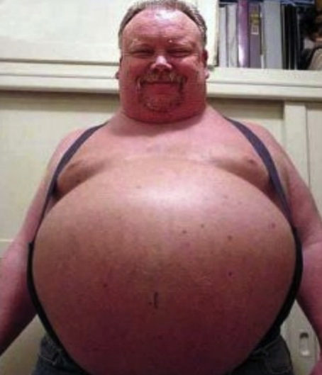

Obesity type
Android vs Gynoid

Slide 34
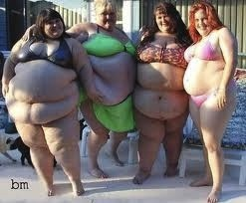
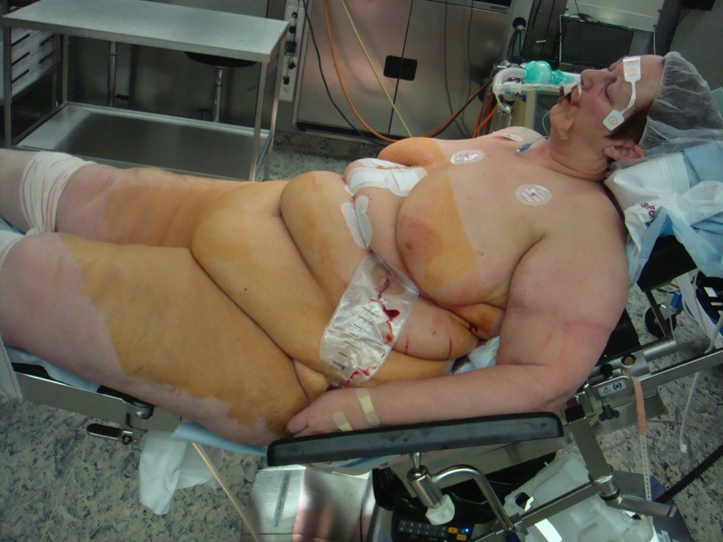
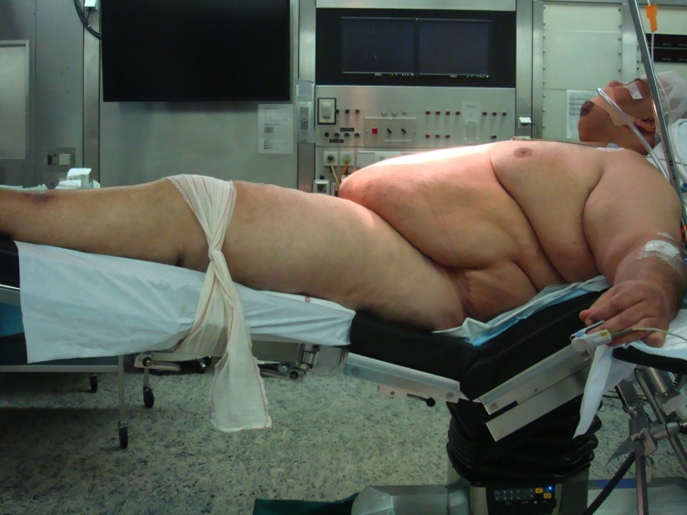
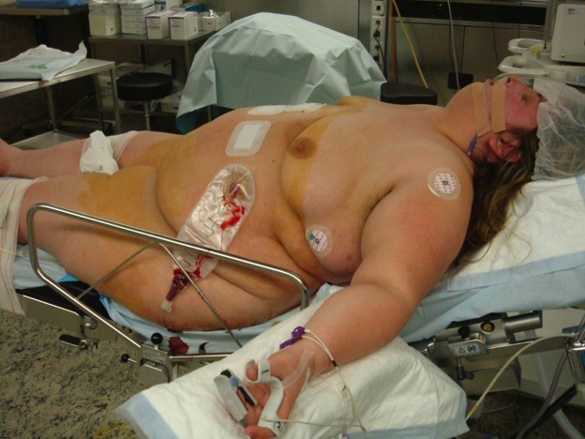
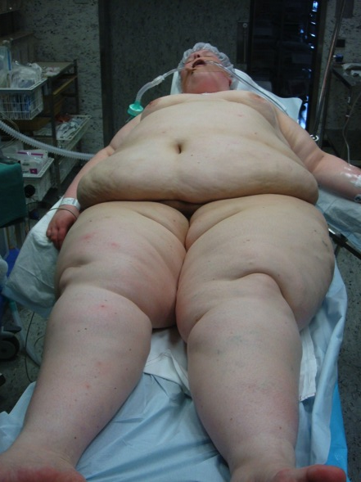
The Pears

Slide 35

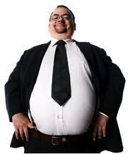
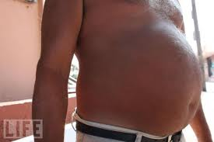
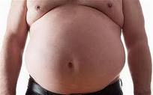


The Apples

Slide 36


Two apples WHR > 1,25
Extra abdominal fat intra abdominal fat
PV0 increases E increases

Slide 37

Two types of android obesity
Subcutaneus Fat Visceral fat
Intra visceral adiposity Extra visceral adiposity
Subcutaneus fat is scant and Subcutaneus fat is thick and
intra abdominal fat is thick and intra abdominal fat is scant.

Slide 38



Thicness of external fat

Slide 39





The obese patient is a challenge for anaesthesia if android shape with intra visceral fat.
Loosing 10 kg body weight before operation changes the circle to an ellips.

Slide 40
Conclusion: When are NMB needed?
Measure abd E, PV0 or IAV at 15 mmHg IAP
If IAV < 4 liter at 15 mmHg
If PV0 > 5 mmHg ( morbid obese patients)
If E > 3 mmHg/L ( never pregnant, small abdomen)
Patient needs continuously NMB during laparoscopy,
Inform your surgeon that despite the increase in workspace with deep NMB, beach chair position, higher inflation pressures to 20 mmHg and ventilation adaptations sufficient space might not be reached. Measure to know

Slide 41

A. Use of Deep Muscle Relaxation in Laparoscopic Bariatric Surgery: J P Mulier
B. Importance of Deep Muscle Relaxation for the Laparoscopic Surgeon: B Dillemans
C. Reversal of Neuromuscular Blockade (NMB) in Morbidly Obese Patients: P Van Lancker
D. Using ERAS (enhanced recovery after surgery) for Laparoscopic Bariatric Surgery: J P Mulier
Cape international Bruges 6 7 March 2012
1150 1850 1947 1977 2010
Dr Bruno Dillemans
Bariatric surgeon
Sint-Jan Brugge-Oostende, Belgium

Slide 42

How a surgeon recognizes insufficient neuro muscular blockade?
At the first inflation with the verres needle
  High abd pressure to start > 10 mmHg
  No flow is going inside
  Multiple attempts to reposition the verres needle
Insufficient space to reach certain laparoscopic area’s
  Last stapler for pouch construction
  Flat access means that insufficient different angles can be used
During surgery or at end surgery, patient start to press suddenly
  Abdominal wall and diaphragm movements
  Coughing or breathing against ventilator, ventilator alarm
  Sudden higher pressures intra abdominal than the set value, inflator alarm.
  No laparoscopic view suddenly, lense need frequent cleaning

Slide 43




1 liter workspace no NMB pressure 11
Not sufficient workspace
no access to upper abdomen
2 liter workspace no NMB pressure 13
Ceiling is higher but still not enough workspace
3 liter workspace no NMB pressure 15
Sufficient workspace for upper abdomen
4 liter workspace with NMB pressure 14
Sufficient workspace and easy access.

Slide 44

What happens if patient breaths against ventilator?
Inflator alarm goes off, high pressure (41), no flowc(0)
Inflator ads flow if pressure drops, it never releases if pressure rises.
No view at all
  Stop surgery and wait till abdomen get relaxed
  Sometimes never relaxed, what is given?
  Request to give more and more without effect?

Slide 45
Difference between active contraction and relaxation
No muscle relaxation
Active contraction against ventilator
Full muscle relaxation

Slide 46


Surgical prediction of difficult access:
Apple sized persons, most frequent male.
Women who have never been pregnant.
First laparoscopy.
Max weight at moment of surgery.
Double bubble abdomen.
  Too much leg flexion makes instrument mobilisation difficult
  Small abdomen?
Type of surgery and place of intervention
  Diaphragmatic access, …

Slide 47




Other techniques used to improve surgical wokspace and access:
Patient position
  Beach chair, anti trendelenburg improves access to upper abdomen even if workspace declines.
Higher intra abdominal pressures
  Max 20 mmHg possible
Standardisation of surgical procedure
  Know what to do
Short overstretching of abdomen at moment of difficult access. ARM procedure.
Longer overstretching during surgery
Weight reduction with modifast to create abdominal space.

Slide 48
Deep NMB is needed
When we have no space
Or the patient has a small abdomen to start
Or NMB is not very deep anymore at the diaphragm and abdominal wall
  Even with TOF = 0 we can see sometimes movements
  Intermittent bolus gives moments of insufficient NMB

Slide 49

A. Use of Deep Muscle Relaxation in Laparoscopic Bariatric Surgery: J P Mulier
B. Importance of Deep Muscle Relaxation for the Laparoscopic Surgeon: B Dillemans
C. Reversal of Neuromuscular Blockade (NMB) in Morbidly Obese Patients: P Van Lancker
D. Using ERAS (enhanced recovery after surgery) for Laparoscopic Bariatric Surgery: J P Mulier
Cape international 6 7 March Bruges 2012
1150 1850 1947 1977 2010
Dr Philippe Van Lancker
Anaesthesiologist
Sint-Jan Brugge-Oostende, Belgium

Slide 50

Importance of Achieving TOF ≥0.9
A
B
C
D
E
25
[mm]
Minimum retroglossal upper airway diameter during forced inspiration
20
*
15
*
Baseline
TOF 0.5
TOF 0.8
TOF 1.0
TOF 1.0
+15 min.
*
*P<0.05 versus baseline
Eikermann, et al. Am J Respir Crit Care Med. 2007;175:9-15.
Notes:
Partial neuromuscular transmission failure by NMB can evoke dysphagia and decreased inspiratory airflow, increasing the risk of susceptible patients to develop severe pulmonary complications.
This study assessed whether impaired neuromuscular transmission due to NMB predisposes individuals to inspiratory upper airway collapse.
The retroglossal upper airway diameter increase observed during forced inspiration recovered to baseline values with recovery of the TOF ratio to unity.
Images on this slide show that a partial paralysis evokes an impairment of upper airway diameter increase during forced inspiration.

Slide 51
Pharynx Dysfunction Increases the Aspiration Risk
150
Human volunteers
Partially paralyzed
100
Upper oesophagal
Sphincter resting tone
(mm Hg)
50
0
Control
TOF 0.6
TOF 0.7
TOF 0.8
TOF 0.9
Degree of Neuromuscular block
Eriksson LI, et al. Anesthesiology. 1997;87:1035
Notes:
The return of the pharynx and upper airway to normal function is essential in post-operative patients after tracheal extubation.
At TOF ratios of 0.6, 0.7, and 0.8 there was a marked reduction in the upper oesophageal resting tone.
After recovery to a TOF ratio >0.9, the upper oesophageal resting tone returned to a level similar to that of the control.

Slide 52
The Clinical Benefits of
Routine Monitoring and Reversal¹
Intraoperative NMB agents’ monitoring and/or antagonisation
Postoperative residual neuromuscular blockade in recovery room (TOF ratio <0.9)
NMB=neuromuscular blockade; TOF=train of four.
1. Baillard C et al. Br J Anaesth. 2005;95:622–626.
Notes:
52
The use of routine monitoring and reversal of NMB may provide clinical benefits.
Over a 10-year period, there was an inverse relationship between the percentage of patients who received reversal or monitoring of NMB and the percentage of patients who had residual blockade in the recovery room.
As neuromuscular blockade monitoring and reversal increased, the proportion of patients with postoperative residual blockade decreased.

Slide 53
Neostigmine is Less Effective in Obese Patients
Obese patients are more difficult to reverse with neostigmine.
Suzuki T, et al. Br J Anaesth. 2006; 97 (2): 160–163.
Notes:
The purpose of this study was to compare neostigmine-induced reversal of vecuronium in normal weight, overweight and obese female patients.
Anaesthesia was induced and maintained with fentanyl, propofol and nitrous oxide.
Neuromuscular block was induced with vecuronium 0.1 mg/kg on the basis of the patient’s real body weight and was monitored using acceleromyographic
train-of-four (TOF) of the adductor pollicis. All patients received neostigmine 0.04 mg/kg combined with atropine 0.02 mg/kg at 25% recovery of the first twitch (T1) of TOF and were allowed to recover to a TOF ratio of 0.9.
Although not shown here, the time from administration of vecuronium to spontaneous recovery of T1 to 25% of control was significantly longer in the and
the overweight groups as compared with the normal weight group.
The times for facilitated recovery with neostigmine to a TOF ratio of 0.7 did not differ among groups. However, the recovery to a TOF ratio of 0.9 in the obese and the overweight groups were significantly longer than that in the normal weight group.
Recovery to a TOF ratio of 0.9 is slow in overweight and obese patients when vecuronium is dosed on the basis of the patient’s real body weight.

Slide 54


Predictability and Consistency of Sugammadex Reversal in Moderate and Deep NMB
Reversal from 1 to 2 PTCs
following rocuronium¹ 0.6 mg/kg
Reversal from T2
following rocuronium² 0.6 mg/kg
% of Patients Returning to TOF 0.9
% of Patients Returning to TOF 0.9
Sugammadex 4 mg/kg
(n=37)
Sugammadex 2 mg/kg
(n=47)
NEO 70 μg/kg (n=37)
NEO 50 μg/kg (n=45)
NMB=neuromuscular blockade; PTCs=posttetanic counts; TOF=train of four; NEO=neostigmine.
1. Adapted from Jones RK et al. Anesthesiology. 2008;109:816–824. 2. Adapted from Blobner M et al. Eur J Anaesthesiol. 2010;27:874–881.
Notes:
This slide shows the time to full recovery from deep rocuronium-induced neuromuscular blockade after administration of sugammadex or neostigmine and the percentage of patients who achieved a train-of-four ratio of 0.9 at various times.
In an exploratory analysis, the total rocuronium dose (ie, intubating dose alone vs intubating dose plus maintenance doses) had no effect on recovery time with sugammadex.
In addition, the time to full recovery was similar when lower doses of sugammadex or neostigmine were used.

Slide 55
Sugammadex Increases Likelihood that Extubation Occurs at TOF ≥0.9¹
b
c
c
a,b
≥
≤
≤
≤
ª P<0.0001 for sugammadex vs neostigmine (Fisher’s exact test).
^{b} Includes 7 patients in the sugammadex group and 5 patients in the neostigmine group in whom the monitor was switched off before extubation because the patient was already awake or moving but who had reached a train-of-four (TOF) ratio of ≥0.9.
^{c} Patients with data available: In total, 3 patients (1 sugammadex and 2 neostigmine) were excluded from
the figure because monitoring was stopped before extubation, as the patient moved or woke up. In addition,
1 neostigmine patient was not included because the TOF trace was considered to be unreliable.
1. Sabo et al. J Anesthe Clinic Res. 2011;2:1–7.
Notes:
In this multicentre study, the recovery of patients after rocuronium-induced NMB using either sugammadex 4.0 mg/kg or neostigmine 50 μg/kg plus glycopyrrolate 10 μg/kg was compared.
At the time of extubation, a TOF ratio of ≥0.9 had been reached in 96.0% of patients in the sugammadex group compared with 39.5% of patients in the neostigmine group.

Slide 56
Effects Of Rocuronium on Morbidly Obese Patients
Rocuronium 0.6 mg/kg:
RBW: Real body weight (BMI>40)
IBW: ideal body weight (BMI>40)
NBW: RBW in non obese patients (BMI < 25)
Group | BMI | Weight (kg) | Onset (sec) | Duration 25% (min)
RBW (n=6) | 43.8 ± 2.1 | 111 ± 13 | 77.0 (37-92) | 55.5 (43.6-60.1)
IBW (n=6) | 43.3 ± 5.8 | 114 ± 21 | 87.5 (54-99) | 22.3* (21.1-24.9)
NBW (n=6) | 22.1 ± 1.8 | 62 ± 8 | 66.5 (50-85) | 25.4* (18.4-31.1)
* P<0.001 vs Real Body Weight
Leykin Y et al. Anesthesia Analgesia. 2004;99:1086-1089.
Notes:
Consideration of the pharmacodynamic effects of an NMB are important when using an NMB in morbidly obese patients.
In this study, 12 morbidly obese female patients (body mass index 40 kg/m²) admitted for laparoscopic gastric banding were randomized into two groups.
Group received 0.6 mg/kg of rocuronium based on real body weight
Group 2 received 0.6 mg/kg of rocuronium based on ideal body weight.
A control group of 6 normal-weight female patients admitted for laparoscopic surgery, received rocuronium on the basis of their real body weight.
The NMB duration of action to 25% of twitch tension was more than double in Group 1 (55 min) compared with the other two groups (22 and 25 min; P <0.001).
Duration of action was similar between Group 2 and control
In morbidly obese patients, the duration of action of rocuronium is significantly prolonged when it is dosed according to real body weight.

Slide 57
Ideal vs Corrected Body Weight for Dosage of Sugammadex in Morbidly Obese Patients
*
*
seconds
IBW=ideal body weight; RBW: real body weight
Van Lancker P, et al. Anaesthesia. 2011;66(8):721-725.
*P<0.001 versus RBW
Notes:
To date, the dosing of sugammadex has based on real body weight without taking fat content into account.
This study compared the reversal of profound rocuronium-induced NMB in morbidly obese patients using doses of sugammadex based on four different weight corrections.
100 morbidly obese patients, scheduled for laparoscopic bariatric surgery under propofol-sufentanil anaesthesia, were randomly assigned four groups:
ideal body weight; ideal body weight + 20%; ideal body weight + 40%; and real body weight.
Patients received sugammadex 2 mg/kg, when adductor pollicis monitoring showed two responses.
There was no residual paralysis in any patient. Morbidly obese patients can safely be decurarised from rocuronium-induced NMB T1-T2 with sugammadex dosed at 2 mg/kg ideal body weight + 40% (P < 0.0001).

Slide 58
NMB During Laparoscopic Surgery in Morbidly Obese Patients
Deep muscle relaxation may provide and maintain sufficient surgical workspace
A patient being fully awake and able to take deep breaths postoperatively is important
Neostigmine has an unpredictable and very long decurarisation time to reach a TOF ratio >0.9
Sugammadex provides predictable reversal in moderate and deep NMB

Slide 59

Perfect reversal in morbidly obese patients prevents pulmonary complications
Retrospective analysis of 948 consecutive morbid obese patients before vs. 948 consecutive morbid obese patients after availability of sugammadex.
1st march 2009: sugammadex available
Mulier JP, ESA 2011
Respiratory failure
Re intubation
CPAP different from OSA
Hypercapnia post op
Intensive care admission

Slide 60


Self in bed is possible after sugammadex

Slide 61
Conclusion B: Laparoscopy in morbid obese patients
deep muscle relaxation is needed
reaching a TOF 90 % is essential
being full awake and taking deep breaths is important
Neostigmine has a total unpredictable and very long decurarisation time to reach a TOF 90% in comparison with non obese patients.
Neostigmine has not a central arousal effect.
This is easily achieved with Sugammadex whatever the NMB depth.
Dosis in morbid obese patients follows TBW till a BMI of 40.
Above BMI 40 keep dosis constant.

Slide 62
A. Use of Deep Muscle Relaxation in Laparoscopic Bariatric Surgery: J P Mulier
B. Importance of Deep Muscle Relaxation for the Laparoscopic Surgeon: B Dillemans
C. Reversal of Neuromuscular Blockade (NMB) in Morbidly Obese Patients: P Van Lancker
D. Using ERAS (enhanced recovery after surgery) for Laparoscopic Bariatric Surgery: J P Mulier
Cape international Bruges 2011
1150 1850 1947 1977 2010
Sint-Jan Brugge-Oostende, Belgium

Slide 63
4000 consecutive lap RNY
Less complications

Slide 64
4000 consecutive lap RNY
Increase in males, diabetes, revisions

Slide 65

ERAS -> short turn-over times.
Non-surgical time: last stitch till incision next patient
Try to reach 30 minutes “Dexter”
We reach less than 30 min on average
Why is this possible?
  Rapid awakening and extubation:
  Induction Room use:
  Rapid switching: patient out and next patient into room
  SPT Short pre-incision surgical preparation time

Slide 66

ERAS (enhanced recovery after surgery)
Keep NMB till end of surgery if abomen is small
Prevent post op leak
Prevent post op bleeding
Improve peripheral circulation
Prevent post op atelectasis
Prevent post op pain
start spontaneous breathing early during surgery using support ventilation
Prevent post op aspiration
tromboprophylaxis

Slide 67





leak test rapid injection of 150 ml blue water and air

Slide 68



Positive leak test at the staple line
First leak test is positive
Suture 1
Suture 2
Second leak test is negative

Slide 69


Positive Leak test submucosal followed by control after suture
RNY: 150 -> 300 ml syringe 150 ml
Sleeve: 300 -> 600 ml air only under water

Slide 70





Local infiltration

Slide 71


Use SAP increase to reduce post bleeding
Increasing blood pressure at end of surgery allows surgeon to find possible bleeding arteries and by clipping preventing post operative bleeding.
Mulier JP Obes Surg 2007, 17: 1051
110/57 145/78

Slide 72


ASA 2010
A
B

Slide 73
Hypercarbia effects
Bille-Brahe NE Acta Chir Scand Suppl. 1976; 472: 127 Cardiovascular effects of induced hypercarbia during halothane-nitrous oxide anaesthesia.
Heart rate, cardiac index, systemic and pulmonary blood pressures rose as pCO2 was increased. Stroke volume, systemic and pulmonary vascular resistance remained unchanged.
In conclusion the primary effect of hypercarbia was an increased heart rate and a resultant increase of cardiac output.
The pressure changes merely reflect the effect on cardiac output.

Slide 74
Hyperventilation
Hyperventilation prevents spontaneous ventilation
Hyperventilation and normoventilation
  Induces lung injury by stretching. Volutrauma
  Bronchoconstriction and increased permeability of bronchial airway epithelium
  Systemic vasoconstriction, reduced cardiac output
Post operative reduced reserve of bicarbonate
  Even when et CO2 returned to normal
  Reduction of bic is fast, build up takes hours till 24 H?
  Resp depression = sleep apnoe ? or = hyperventilation?

Slide 75
Hypoventilation and hypercarbia
protection of the lungs
Hypoxic pulmonary vasoconstriction better VA/Q matching
Rightward shift of the oxyhemoglobin dissociation curve
Cardiac output rises
  which appears to be directly related to both hypercapnic acidosis per se and to hypercapnia-induced sympathetic activation and release of catecholamines
Systemic arterial vasodilation
  10 mmHg increases the cardiac index by about 10–15%
Suppresses many cellular functions, the overall local effect is reduced local O2 consumption
Increases oxygen availability to tissue effects ? On infection, healing, oedema,…

Slide 76



Hemodynamic effects of Hypercapnia (vs hypoxia)
Peripheral chemoreceptor contributions to sympathetic and cardiovascular responses during hypercapnia.
Shoemaker JK Can J Physiol Pharmacol. 2002; 80: 1136.

Slide 77
Permissive Hypercapnia vs Normocapnia under general anesthesia in obese patients
Mulier JP Anesthesiology ESA 2008 A174
.
Less ephedrine is needed to elevate SAP due to CO increase

Slide 78



Effect of et CO2 on blood pressure

Slide 79
To what depth of NMB is PSV possible?
Profound muscle relaxation does never disturb pressure support ventilation.
Mulier JP 2009 PGA

Slide 80
High dose Morphine blocks respiratory center making PSV impossible.
PTC 1
TOF 4/4
TOF 0/4
PTC 1
TOF 1/4
Escape PCV
RR
Roc
Suf
Casier I, Mulier JP ESA 2010
Aestiva S/5 with a trigger sensitivity of less than 0.6 L/min. Backup ventilation mode was set to start after 30 second of no ventilation.
Rocuronium infusion was given at 500mg/h till TOF and PTC were 0.
Then Rocuronium infusion was stopped en Sufentanil 25µg was given.

Slide 81

Opioid free anesthesia (OFA) improves the comfort and reduces the post operative pain

Slide 82

Chronic Postoperative persistent Pain….
11.5 to 47 %
of the patients undergoing surgery !!
Perkins & Kehlet, Anesthesiology 2000

Slide 83


Hyperalgesia to opioids….
Intraoperative Remifentanil Increases Postoperative Pain and Morphine Requirements
(Guignard, Chauvin: Anesthesiology 2002)
Independent Predictive Factors of Severe Postoperative Pain in the Postanesthesia Care Unit
The dose of intraoperative opioid !!
(Aubrun, F. et al. Anesth Analg 2008;106:1535)
R
No R
  Intensity of post op pain is proportional to the dose of opioids given during anaesthesia.

Slide 84
Obesity and morphine
Obesity is a chronic pro-inflammatory disease.
  It exposes to chronic post surgical pain.
Opioids are naturally hyperalgesic by direct interaction with the NMDA system.
  Intense agonism of the u-excitatory receptors lead to overexpression of the NMDA nr2b receptors in the forebrain.
    This is associated with increased inflammatory and chronic pain.
Immune suppression should be avoided in bariatric surgery
OSAS: use less opioids to prevent post op hypoventilation
Avoid opioids in obese patients.

Slide 85
How I avoid opioids per operative (lap RNY)
No Premedication Epidural if possible, but not done in laparoscopic gastric bypass
Induction for intubation
  Clonidine 150 - 300 ug po avoid sedative doses
  Ketamine 10 – 25 ug iv only painkiller no sedation post op
  Seloken 2 - 5 mg iv according to heart rate
  Propofol (dexmetodine? when availble)
  Xylocaine 1 mg/kg IBW: 70 mg iv intubation and extubation stress
  Rocuronium 0,6 - 1,2 mg/kg
Maintenance
  Desflurane 1 to 2 MAC no TIVA no remifentanyl
  Esmolol according to heart rate & blood pressure
  Paracetamol 3 - 2 gr loading, 1 gr every 6 hours
  NSAID’s if possible
Before awakening
  Pressure support ventilation measuring respiratory rate
  Low Bolus dose of sufentanil: 5 mg piritramide: 10 mg for post op pain
  Local wound infiltration, diaphragm spray

Slide 86


Slide 87
BMI Affects Recovery of Pharyngeal Function
More With Sevoflurane Than With Desflurane
Time From Anesthetic Discontinuation to First Ability to Swallow by BMI
Desflurane Sevoflurane Desflurane Sevoflurane
2,000
1,000
0
Time
(Seconds)
From Anesthetic Discontinuation Until First
Ability to Swallow*
(1000 seconds
= 17 minutes)
P=0.02
P=0.03
15 20 25 30 35 40
Body Mass Index (kg/m²)
* Regarding Swallowing: Administering water to patients after anesthetic discontinuation is not a standard of care.
McKay RE et al.
Br J Anaesth. 2010;104:175-182.
Notes:
[McKay 2010, p.4 of epublished version, Figure1A]

Slide 88
Operating Room and PACA use of opioids

Slide 89



control of gastric bleeding by deep aspiration
Treat if new red blood is aspirated
Empty gastric pouch to prevent post extubation aspiration

Slide 90







Low saturation
Old problem still needs attention
  Atelectasis: peep & recruitment
  Synchronisation problems
New patient population? Extreme age, size
  Neonati - very old – surgery less invasive
  Morbid obese - anorexia
New insight in physiology?
  Volutrauma is more important than barotrauma
  Permissive hypercapnia, hypoxia instead of biotrauma
Measuring atelectasis
Attention & Awareness
Use of peep and recruitment

Slide 91



Prevention of Atelectasis in Morbidly Obese Patients during General Anesthesia and Paralysis
Reinius et al. Anesthesiology 2009

Slide 92





CPAP adapted ventilator used to breath spontaneous or to assist manual with facemask

Slide 93

Old method: 4 pers

Slide 94


Floating hoover: 2 pers

Slide 95
Move themselves in bed after Sugammadex?

Slide 96
ERAS (enhanced recovery after surgery)
Deep NMB till the end
  Sugammadex improves awakening by muscle spindles activation
Large volume leak test
Opioid free anesthesia - high dose paracetamol - low dose morphine post op
  Prevent post op pain
  No sedation low dose ketalar, droperidol, no benzodiazepines
Permissive hypercapnia
  Improve peripheral circulation and hypertension
PEEP - CPAP - PEEP lung recruitment PSV during NMB and lap
  Prevent post op atelectasis
  Accellerate awakening
Taperguard Cuff – gastric aspiration – RSI
  Prevent peri op aspiration
Leg elevation per op
  tromboprophylaxis

Slide 97
Conclusion C: ERAS and sugammadex in morbid obese patients
ERAS improves outcome quality and reduces turnover time
Hypercapnic PSV is possible during deep NMB and
  Improves oxygenation.
  Facilitates weaning to spontaneous breathing
  Allows low morphine dosage without respiratory depression
  Increases cardiac output and blood pressure preventing postoperative bleeding and wound infections.
Desflurane elimination is fast and predictable with early alertness in morbid obese patients compared to propofol and sevoflurane.
Atelectasis and respiratory failure are prevented with
  Peep and Lung Recruitment during ventilation
  Predicatable and fast decurarisation with sugammadex to 90% TOF
  CPAP during extubation
  Early mobilisation in bed and deep breathing maneuvers
Sugammadex makes ERAS possible in morbid obese patients.

